Slide 1

RAD Roadside Drone
Project Leader: Fayez Yusuf
Team Members: Sebastian Colón, Coleman Gamble, Andrew Gonzales, Matthew Hui, Keerthi Koganti, and Parisa Nawar

Slide 2
Scenario & Goal
- Create drone to support two-liter payload
- Immediate fuel delivery in case of emergency
- Demographic: areas with scattered fueling stations
- Create a fuel delivery system to reduce the distance gap
- Inspiration: team leader's recent gas theft

Slide 3
GANNT Chart
Week of | 9/30 | 10/7 | 10/14 | 10/21 | 10/28 | 11/4 | 11/11 | 11/18 | 12/2
Brainstorm, discuss, and finalize objectives
Prototyping and research
Implement designs, run test flights
Document and present final product

Slide 4
Group Member Roles
Mechanical Engineers: Andrew and Keerthi
- Designing CAD models in OnShape, basic drone draft
Electrical Engineers: Coleman and Sebastian
- Configuring drone, cauterizing wiring
Computer Science Engineers: Matt and Parisa
- Interfacing with the autonomous missions
- Creating basic GUI Program

Slide 5
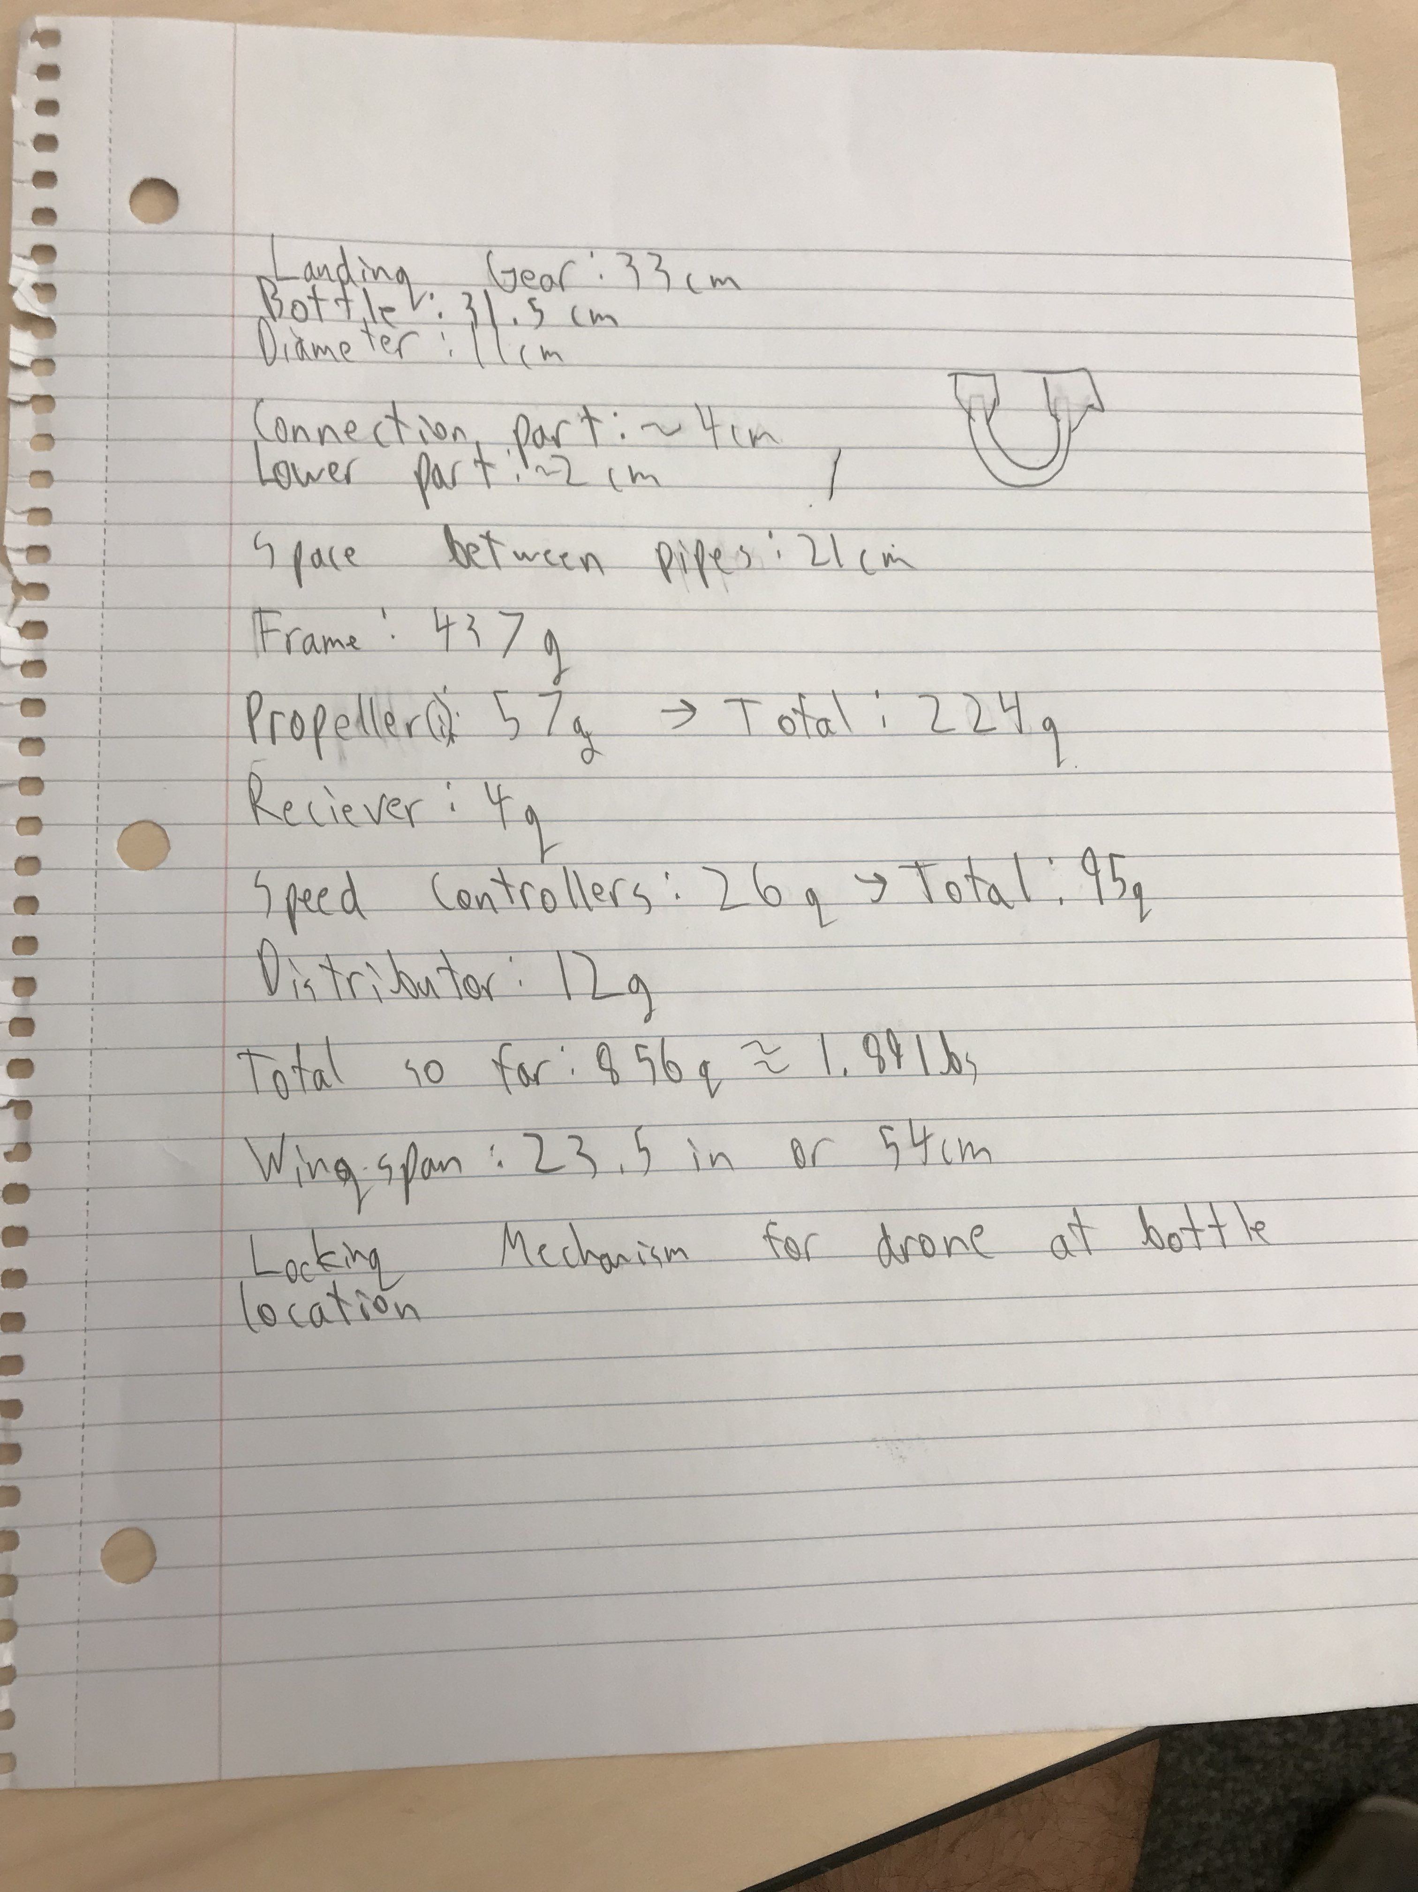
Planning
- Construction & dimensions of payload storage
- Case-by-case differences
- Payload retrieval
- Safety considerations
Source: https://hover.blog/how-to-lead-an-effective-brainstorm-with-your-team-or-just-you/

Slide 6
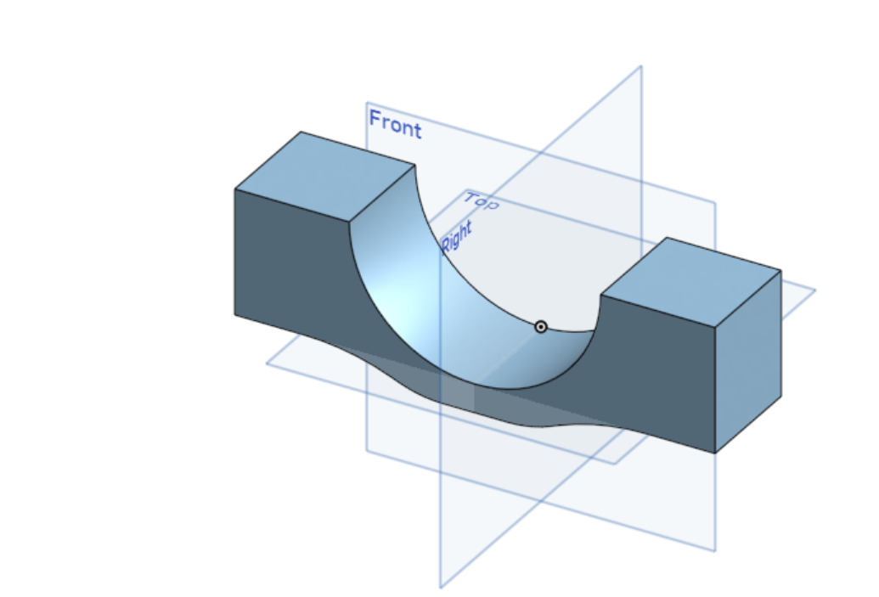
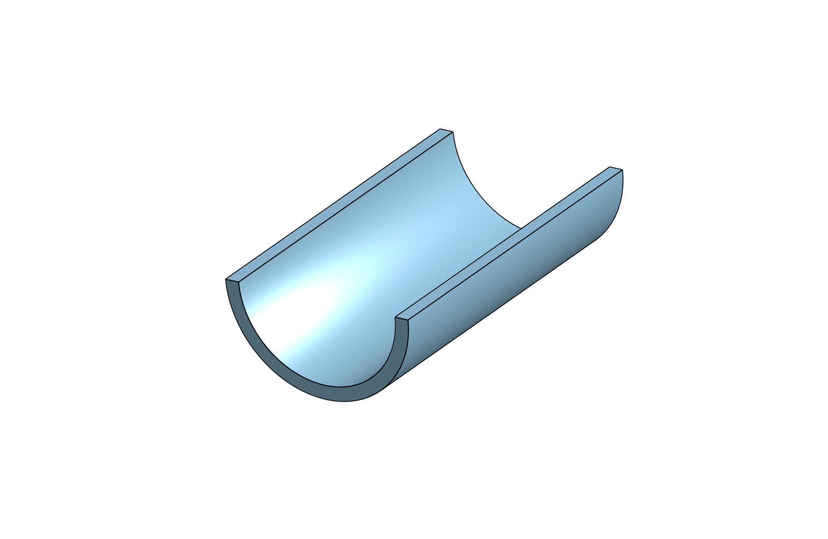

Design
- Horizontal sleeves to hold the ropes
- Selected a design with two attached to front and back

Slide 7
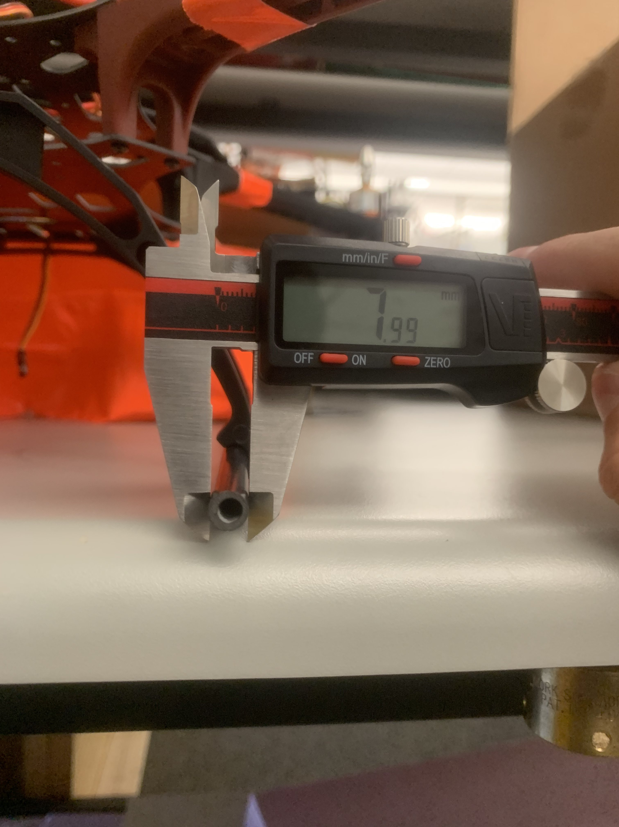
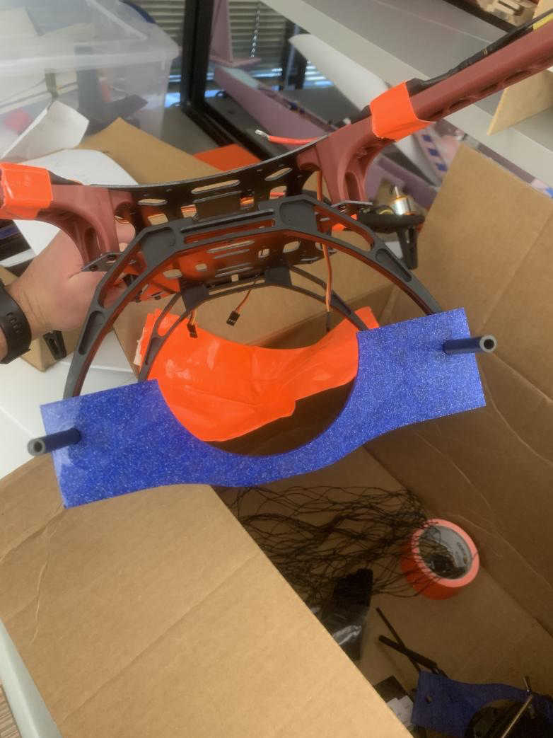
Manufacturing
- 3D printed design using PLA
Lightweight
Cost efficient
- Wire elongation by cauterization
Connect the motors and PixHawk

Slide 8
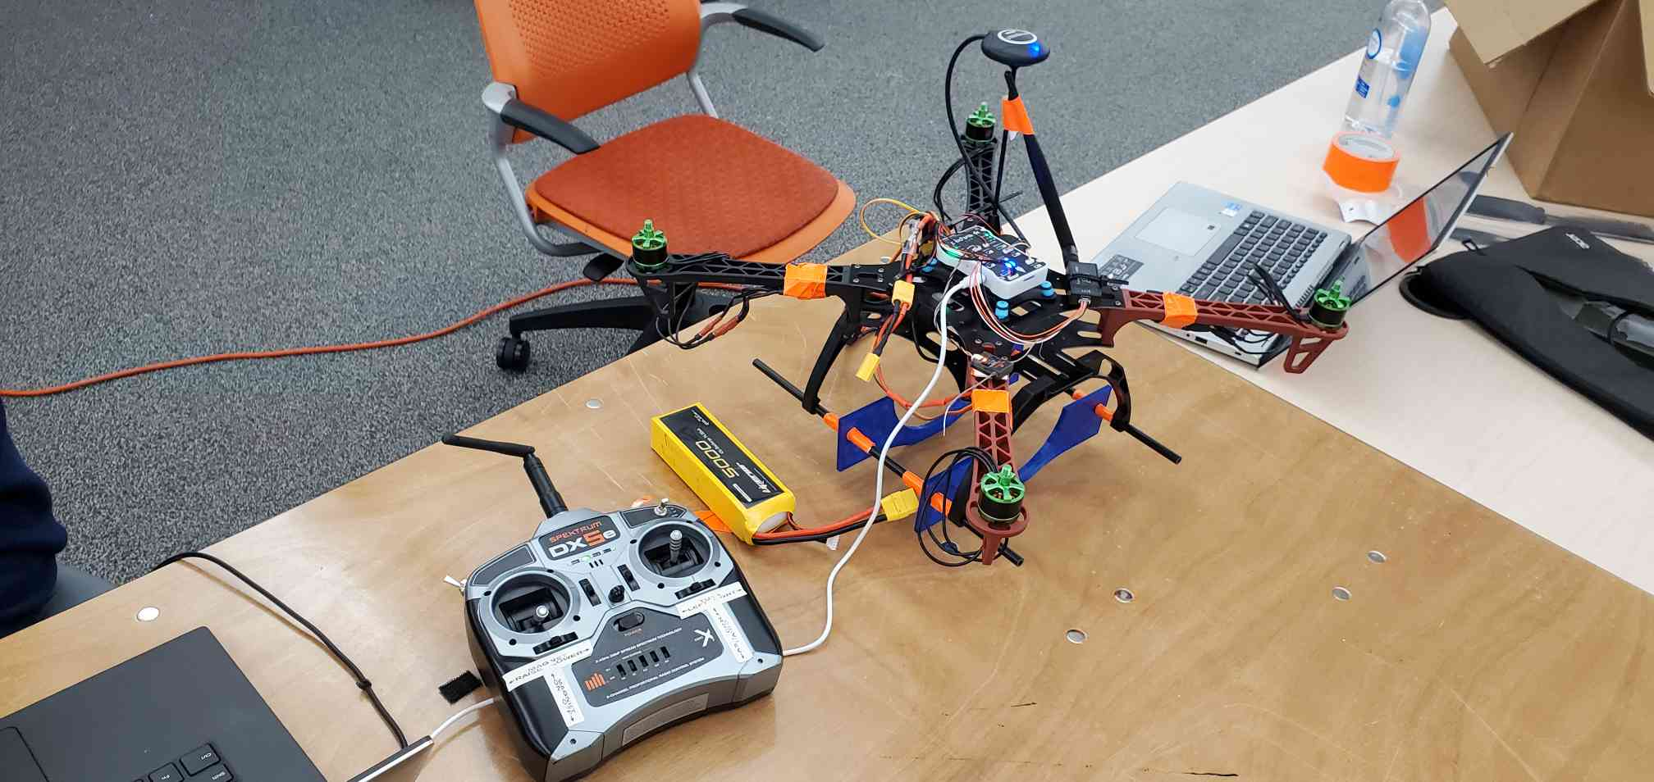

Slide 9
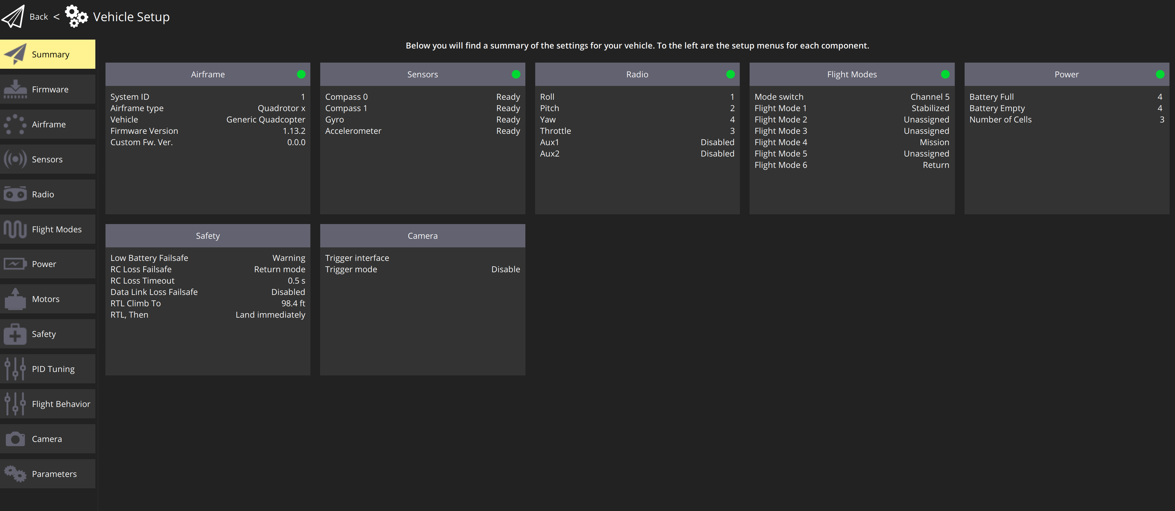
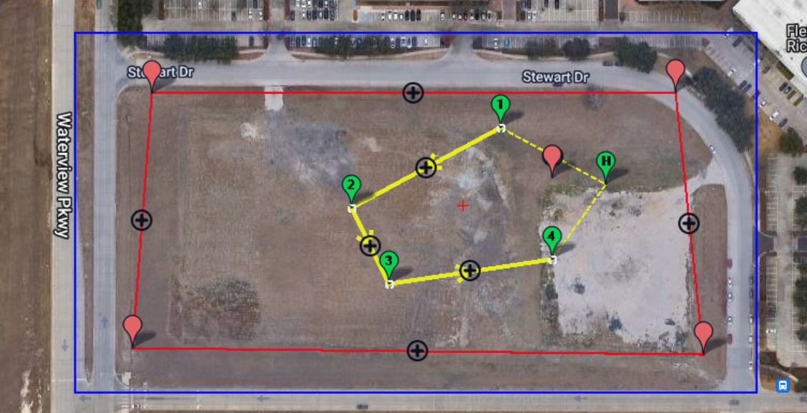
Ground Control Software
QGroundControl (QGC)
- Configuration of telemetry
Mission Planner
- Direct flight organization and landing of aircraft

Slide 10
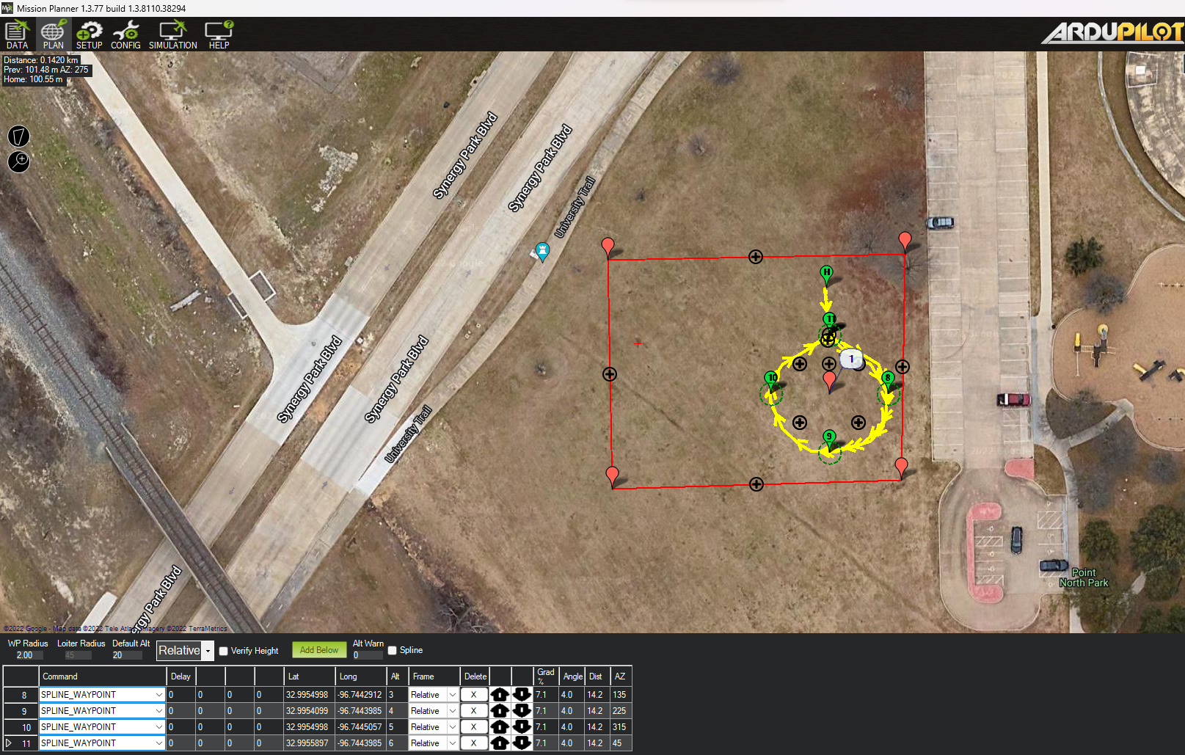

Slide 11
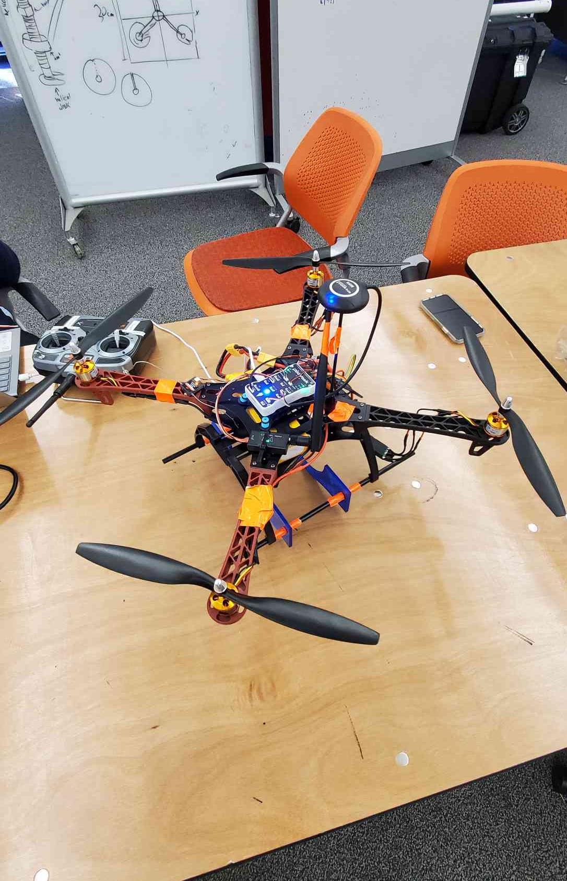
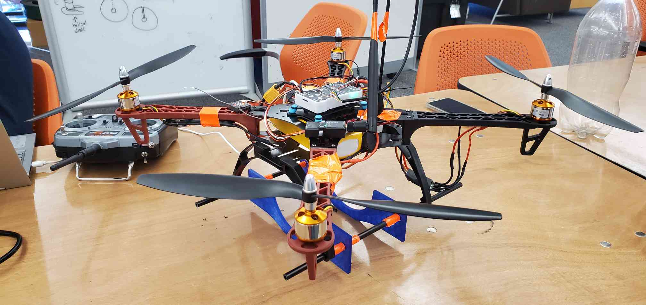

Slide 12
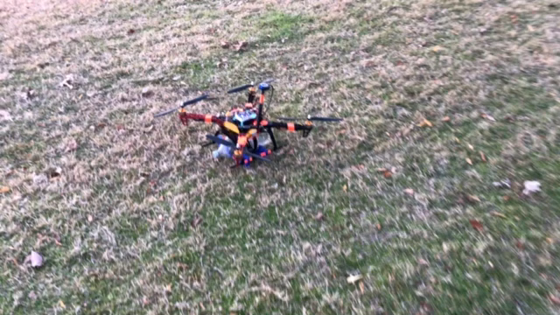

Slide 13
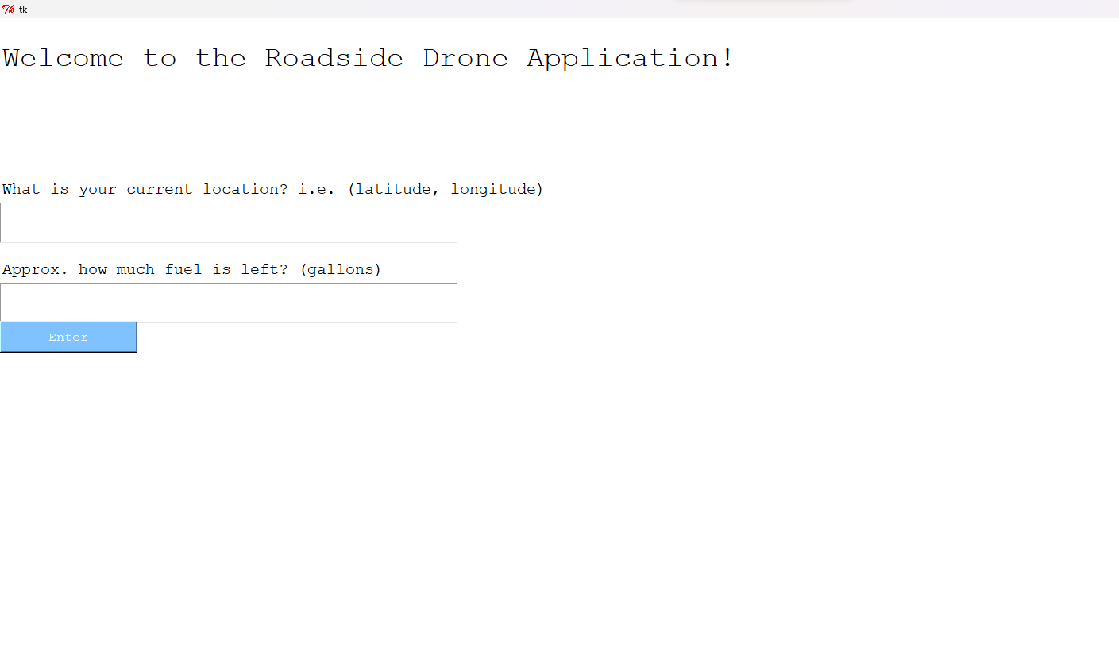
Notes:
As a side addition to our project, we created a barebones outline of the frontend to a potential outline that we'd roll out as part of the roadside assistance service.

Slide 14
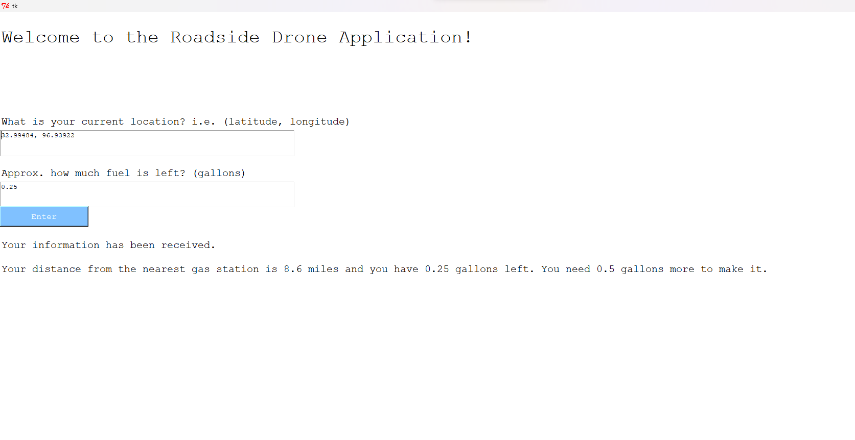
Notes:
Here is an example of the data input and text output – after entering location and fuel information, the application would respond with guidance on nearby fueling stations and also confirmation about fuel delivery.
Given more time and funding, we'd be able to work more on the application to make the frontend more appealing while also possibly connecting with Google's Maps API to actually provide distance and direction to the user.

Slide 15

Limiting Factors
- Budget
- Materials
- Weight
- Distance
- Ground Control Software quality
- Battery

Slide 16
Skills Learned
Future tasks
- Ground control software
- Cauterization
- Wiring
- Teamwork
- Communication
- Patience
- Improve UI
- Add Maps functionality, API
- Robust frame, improved propellers and technology
- Newer ESCs

Slide 17

Questions?
Project Leader: Fayez Yusuf
Yusuf. Fayez@UTDallas.edu
281.839.9441

